Slide 1

Apache SensSoft: Software Usage, Usability, and User Characterization
Dr. Joshua Poore

Slide 2
What is Apache SensSoft?
An open-source, generalized, thin-client behavioral logging capability
Comprehensively collects data from web pages, tools, and browser to capture usage, usability, with enough fidelity for behavioral modeling
Deployment options allow for different applications:
Embedded on a page:
Usage—Track IT acquisition utilization; identify gaps, inefficiencies
User-Testing—Track how adoptable IT acquisitions are
Business Analytics—Track key indicators of effective discovery
Packaged within a web extension allows additional applications:
Enterprise application workflows—Track how tools are used together
Information Navigation—Track how reference materials are consumed

Slide 3
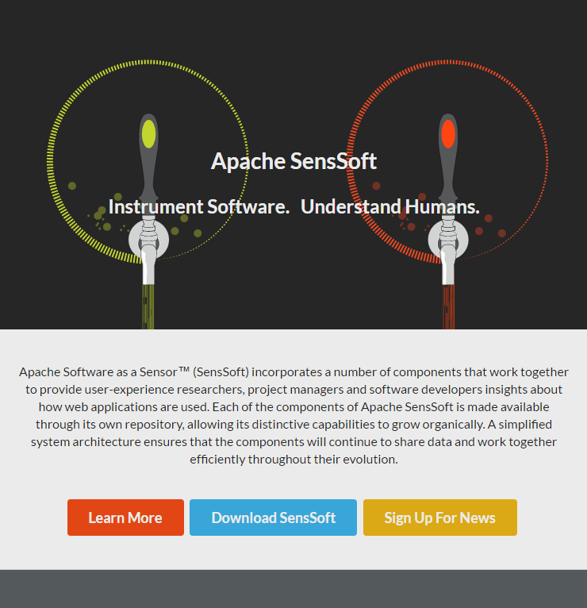
What Problem Drove Apache SensSoft?
Non-invasively collect software user behavior data with minimal infrastructure and comprehensive information suited for behavioral modeling
https://github.com/apache?q=senssoft

Slide 4
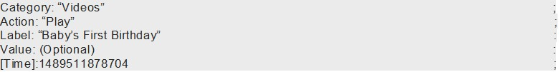
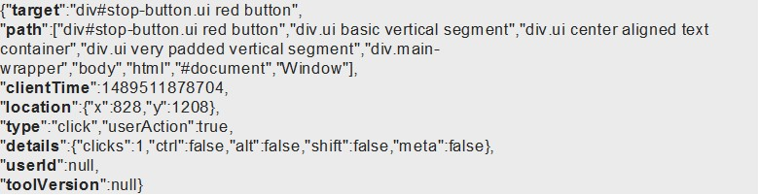
Data Model and Trade-Offs
Field Name | Description
“target” | Page Element Targeted by Action
“path” | Document Object Model (DOM) placement of “target”
“clientTime” | Start of interval (in clientTime)
“location” | Length of interval (in clientTime)
“type” | Event Class (“click”, “mouseover”, etc.)
“logType” | Discrete event (“raw”) or event series (“interval”)
“userAction” | (True/False) Event initiated by user or system?
“details” | Special details from params
“userID” | UserID value passed through params (or null)
“toolVersion” | Version of web application (or null)
“toolName” | Name of web application (or null)
“useraleVersion” | UserALE version
“sessionID” | Unique session with page identifier
“pageURL” | URL/Address of current page (or null)
“Hostname” | Hostname of Client Computer
Google Analytics Log
Apache SensSoft Log
Granularity and holistic logging is more important than human readability, for modeling and posterity.

Slide 5
Discriminators
Noninvasive User Characterization via Software
Observes users to understand their workflow and behaviors. Outperforms current state-of-the-art in predicting cognitive load and performance.
“Low Lift” Instrumentation, Lots of Data
Requires a single line of code added to source. Provides more data and more information than is currently available through other services.
Suited to Modeling User Activities, Not Just Clickstream
Models how users interact with content, not just counts of what they do. Ties software logs to improvements in design cognitive assessment, and teaming.
Configurable, Scalable Platform
Available as open source components to provide initial platform. Modifiable to fit specialized use cases and operates wholly on desired networks (no 3rd party networks or storage).

Slide 6
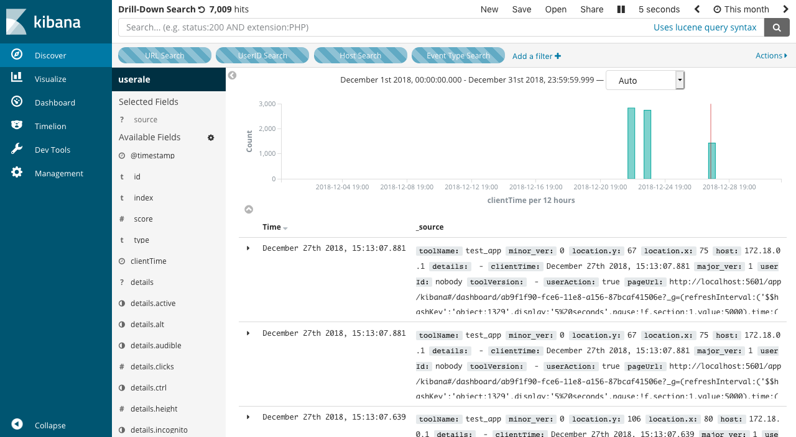
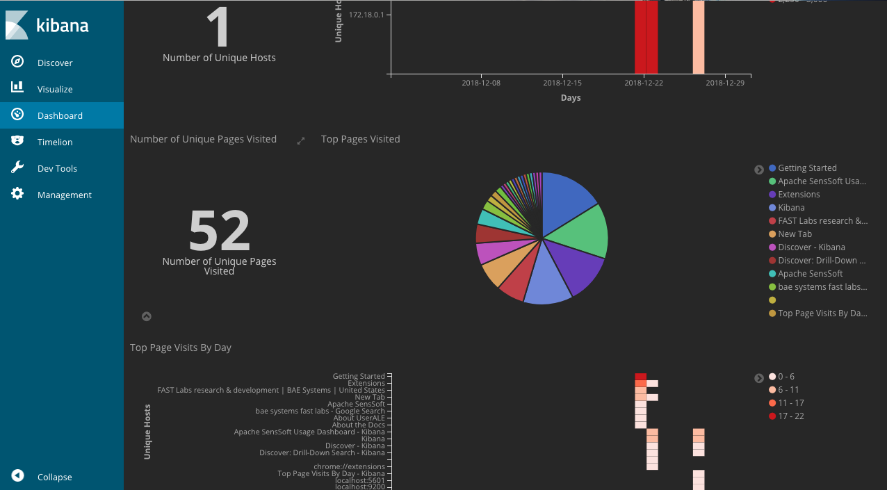
Out of the Box
Comprehensive User Data
Utilization Dashboards
Search, Filter for Records of Users as they Explore Pages,
Sites and Tools
Drill-Down on How Users at
Different Hosts
Explore Pages, Sites, and Tools

Slide 7
Benefits of Apache Open-Source
Apache License v.2 is Maximally Permissible
Stipulates Universal Modification and Distribution Rights
No requirement to push modifications back to open source
Caveat is that License Headers must Remain in Original Source
i.e., can modify, add, and hold proprietary or private modifications and additions, but must track changes and original source must retain license pedigree
Synergies with Other Open-Source
Utilizes other, widely used open source (Elastic, D3)
Community
Gain benefit of experience with an expert community at Apache

Slide 9
Platform and Scaling Considerations
Every deployment is different; considerations and their priority can vary widely based on how Apache SensSoft is used and what it is used for:
Small targeted user studies can run with a few laptops running single-node containers off of Docker Desktops.
Enterprise-level persistent collections can scale in cloud INFRA like Amazon EBS almost indefinitely at nominal costs.
Small-n user studies with integrated analytics or machine learning running in real-time can be far more taxing on Apache SensSoft’s backend than a strict data collection from a much larger user pool.

Slide 10
General Considerations—Storage
Generally speaking, the considerations every Apache SensSoft user will need to be conscientious of are:
Storage:
How many different classes of User Events do you care about?
Scroll, Mouseovers generate massive amounts of data
Clicks, key-downs, tab-behavior are far less voluminous
Do you need a UserALE.js Web Ext to exhaustively capture IT utilization or can I just instrument a few web pages?
Web Extension deployments produce more verbose logs—in Elasticsearch each log is actually a nested .json doc (++space) because Elasticsearch relies on Lucene data structures.
How long do you need logs accessible in Elasticsearch?
Retention policies are important; weekly or monthly dumps of ‘stale’ user-behavior can be efficient ways of preserving space and reducing costs.

Slide 11
General Considerations—Memory
Memory
What else are you going to do with your data, while you’re collecting it?
Elasticsearch is great because it handles document indexing, storage, retrieval, search and query. Use-cases that use all those capabilities at once will tax the backend.
This is also worth considering when standing up services around Apache SensSoft/Elastic—if user logs are used to direct other services or processes, do they need to query Elasticsearch or can Logstash write to an AMQP service to distribute logs in a subscription model.

Slide 12
General Recommendations
There’s no reason to settle for a single Apache SensSoft use-case or a single Apache SensSoft deployment approach.
For targeted, small-n developmental user testing (e.g., usability, A/B tests), lean deployments on laptops with single-node containers running on Docker Desktop are fine.
Assumptions:
< 1 day of heavy application use per container (multiple users on one laptop are OK)
Laptops are modern, with at least 16G-32G Memory
~10GB free space, especially for heavy use over numerous days
Check container health after each user session
Extract (dump) Elasticsearch image regularly (a few times per week)
Data will be analyzed Post-Hoc
Laptops have access to external power (prevent CPU throttling)

Slide 13
General Recommendations
For persistent data collection use-cases: such as between-user workflow analysis, system<>user analyses, etc., multi-vm/server cluster deployments with scaling options are a necessity. However, simple cluster scaling, with load-balancing nodes, such as in Docker Swarm or AWS EBS, may be sufficient (Kubernetes or other enterprise-level scaling tech is best).
Assumptions:
Data Analysis is post hoc
Limited or no services are accessing Elastic
Data retention policies are in place for offloading data in Elasticsearch
Sufficient load-balancing and/or sufficient CPU (>2 core processors) are in place for Logstash
Assess necessity of Mouseover data (possible to collect well over TB given variances in data generation rates with Mouseover data (can range from .03MB/m - .3MB/m), per user)

Slide 14
General Recommendations
For persistent monitoring or producer-consummer like service models tied to Apache SensSoft assets, enterprise-level, horizontal scaling (e.g., Kubernetes) is a necessity.
Each Elastic node should have 64G memory, and run on machines with closer to 8-core processors.
Logstash will also need to be monitored for CPU usage, preferably with load-balancing in place.
A Hot-Warm data retention policy should be in place, regular dumps following analysis (and stored analysis)

Slide 15
Useful References
https://www.elastic.co/blog/hot-warm-architecture-in-elasticsearch-5-x
An interesting data retention approach with Elasticsearch
https://www.elastic.co/guide/en/elasticsearch/guide/current/hardware.html
The definitive guide to hardware considerations for Elastic
https://www.elastic.co/guide/en/elasticsearch/guide/current/heap-sizing.html
Given how Elastic utilizes Lucene, more memory isn’t always better
https://www.elastic.co/guide/en/logstash/current/deploying-and-scaling.html
Logstash scaling concepts and strategies
https://speakerdeck.com/rmoff/building-streaming-data-pipelines-with-elasticsearch-apache-kafka-and-ksql
Apache SensSoft has some support for Kafka, Zookeeper and other interesting ways of managing multi-service data distribution pipelines

